Slide 1
TxCRCP-ME Interface Modification Request
11/22/2021
Pangil Choi, P.E.

Slide 2
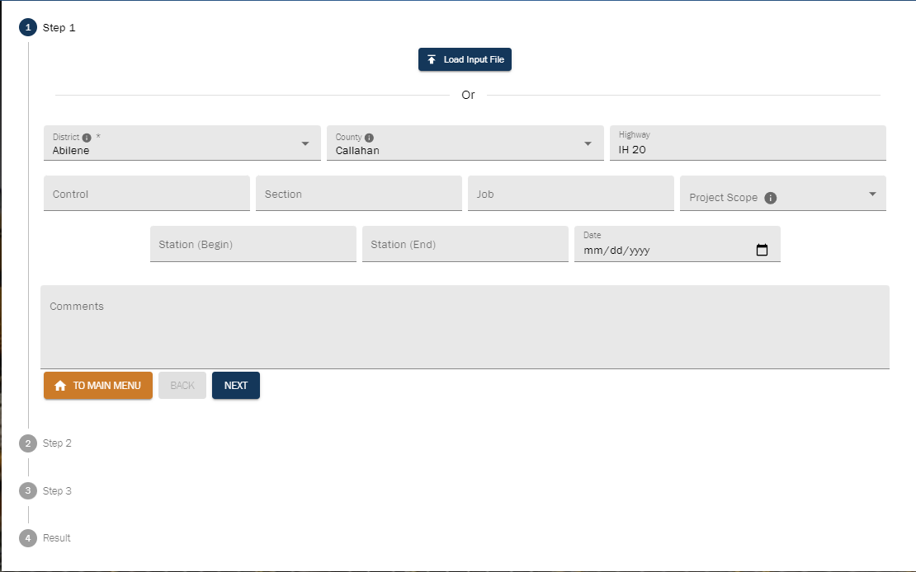
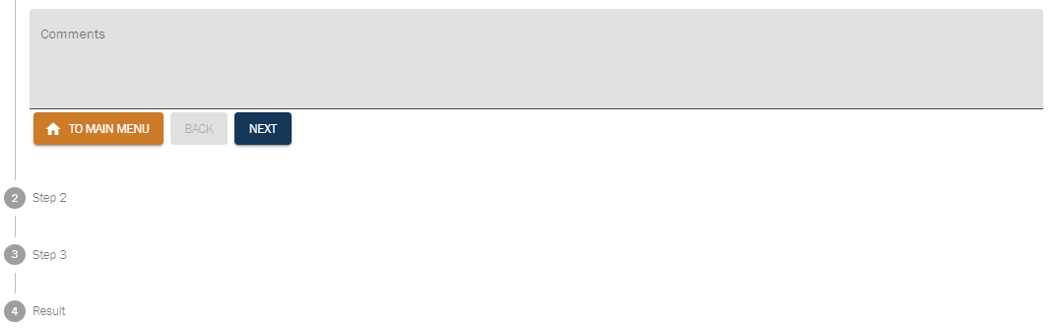
STEP 1
DISTRICT
COUNTY
HIGHWAY
PROJECT SCOPE
CONTROL
SECTION
JOB
DATE
PROJECT LIMITS
ex) From SH 174 to Hill County Line
FROM
TO
STA. BEGIN
STA. END
RM. BEGIN
RM. END

Slide 3
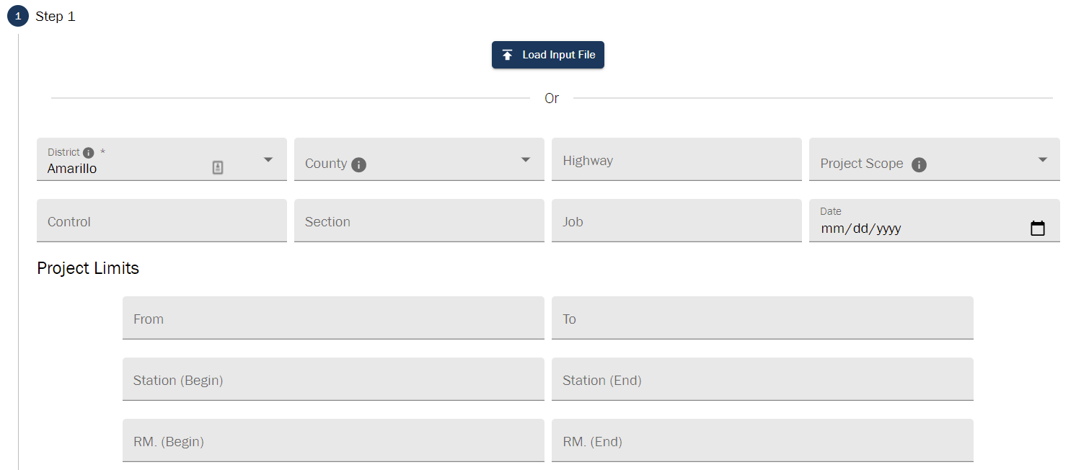

Slide 4
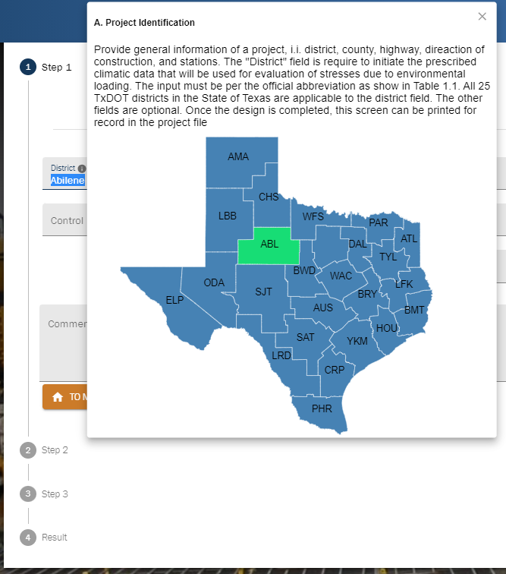
STEP 1/District – Delete
DELETE
Only MAP like County

Slide 5
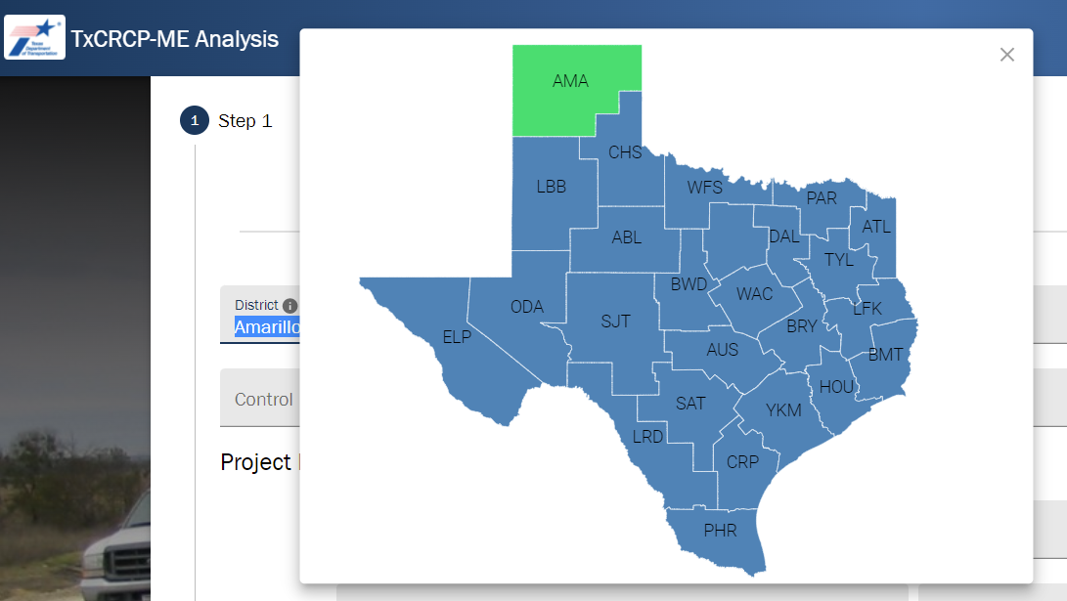

Slide 6
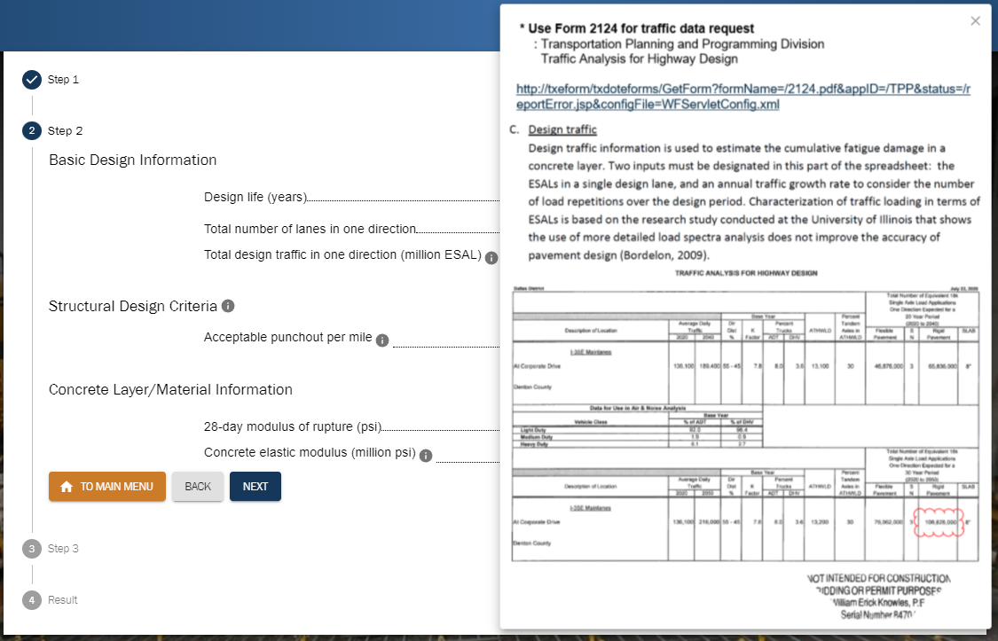
Design Traffic – Replace/Use Higher Resolution Image
* Use Form 2124 for traffic data request
: Transportation Planning and Programming Division
Traffic Analysis for Highway Design
Design Traffic
The traffic projections for a highway project (in terms of ADT and one-way total 18-kip ESALs) are obtained from the traffic analysis report provided by the Transportation Planning and Programming Division (TPP). This report is requested during the design phase of a project and, upon receipt, should be evaluated for reasonableness.
Local conditions may cause the directional distribution of heavy vehicles to be unequal. An example is a location near a major quarry adjacent to a highway with otherwise modest levels of truck traffic. If the designer is aware of local conditions that may result in unequal distributions of heavy trucks, TPP should be informed of this condition when requesting traffic projections, and the reported 18-kip ESALS for pavement design should be adjusted.

Slide 7
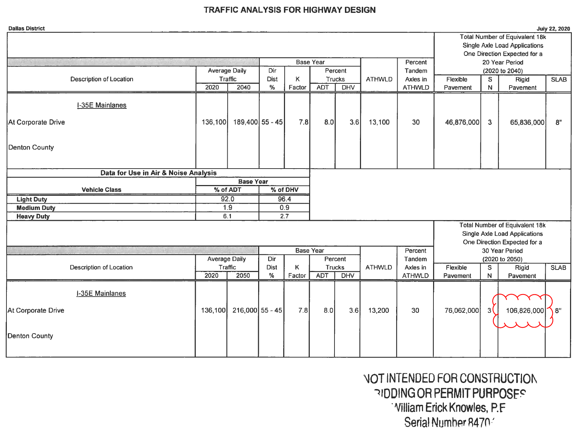

Slide 8
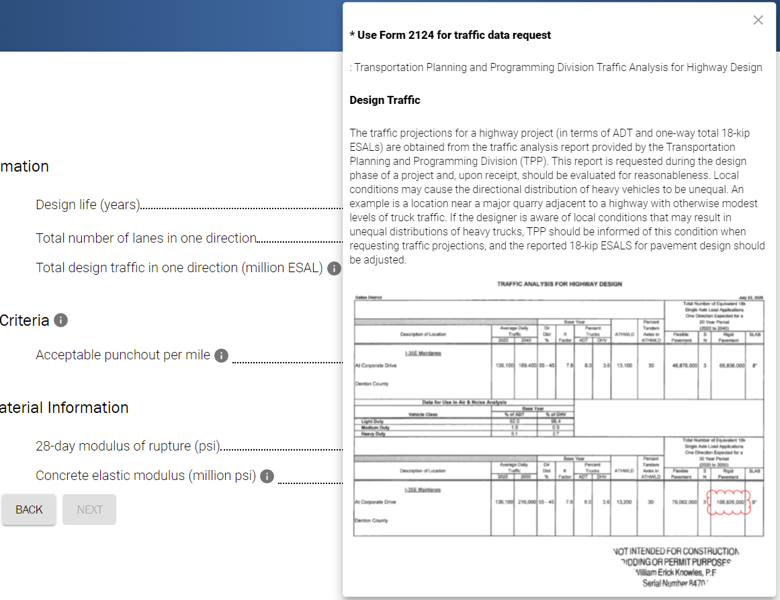
zoomable

Slide 9
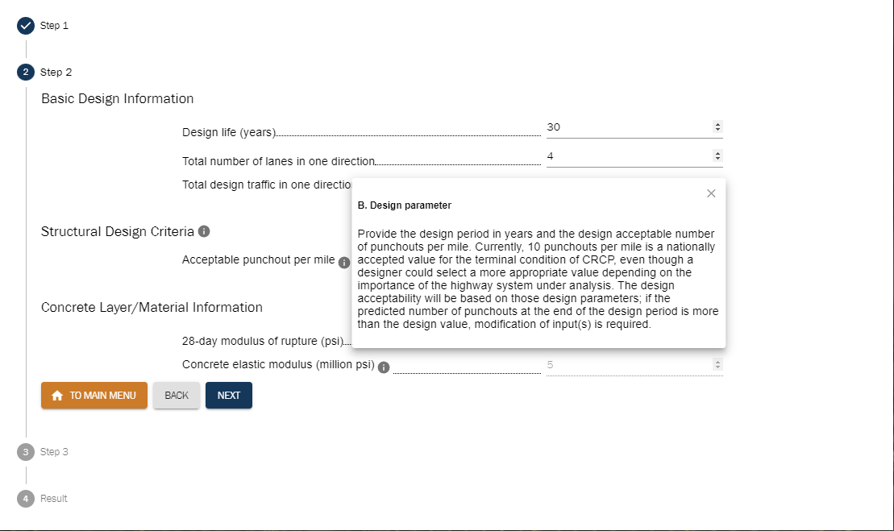
Acceptable Punchout per Mile – Replace
Number of Punchouts per Mile
Provide a number of punchouts per mile that is considered the terminal condition of CRCP you are designing. Traditionally, 10 per mile has been the number used for CRCP design. For a higher class of highway where the number of punchouts may be minimized, contact MNT – Pavement Analysis & Design Branch.

Slide 10
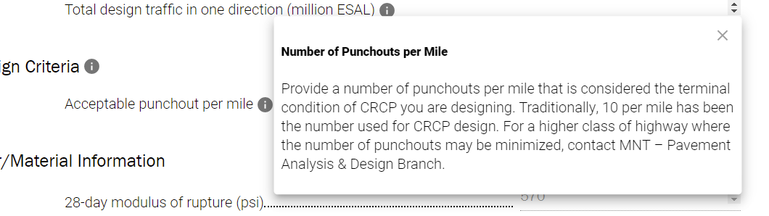

Slide 11
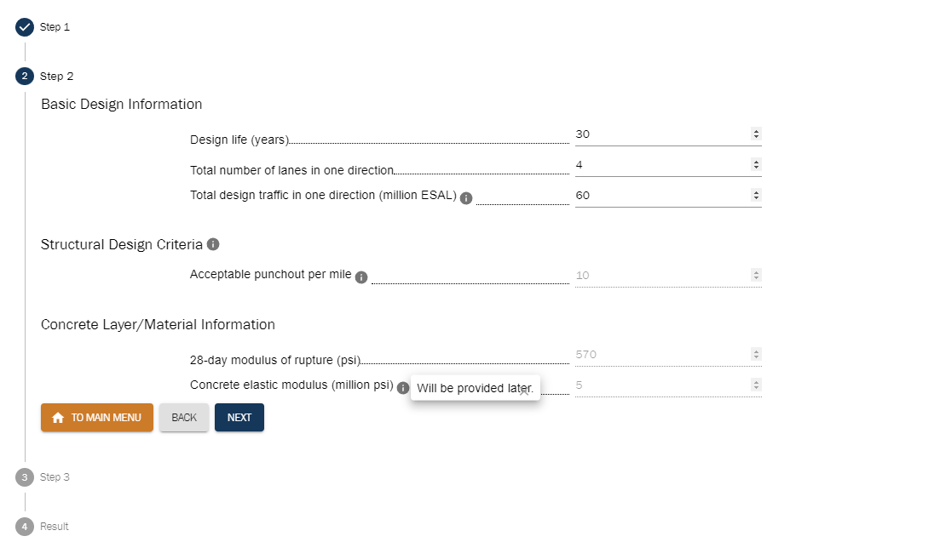
28-Day Modulus of Rupture – Create Information
28-Day Modulus of Rupture
The Modulus of Rupture (M_{r}) of concrete is a measure of the flexural strength of the concrete as determined by breaking concrete beam test specimens. Use a 28-day M_{r} of 570 psi. If the engineer selects an alternate value for M_{r}, it must be documented with an explanation. Also, if a higher M_{r} is used, it should be required in the plan to use a higher concrete strength than what is required in Item 360.

Slide 12
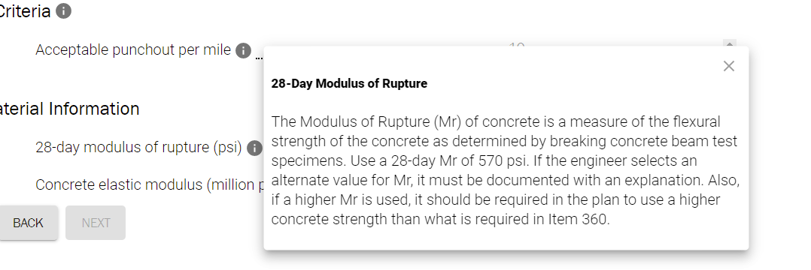

Slide 13
Concrete Elastic Modulus – Create Information
28-Day Modulus of Rupture
Elastic modulus of concrete is an indication of concrete stiffness. It varies depending on the coarse aggregate type used in the concrete. Although the value selected for pavement design could be different from the actual values, the elastic modulus does not have a significant effect on the computed slab thickness. A modulus of 5,000,000 psi should be used for pavement design. The use of a different value must be documented with an explanation.

Slide 14
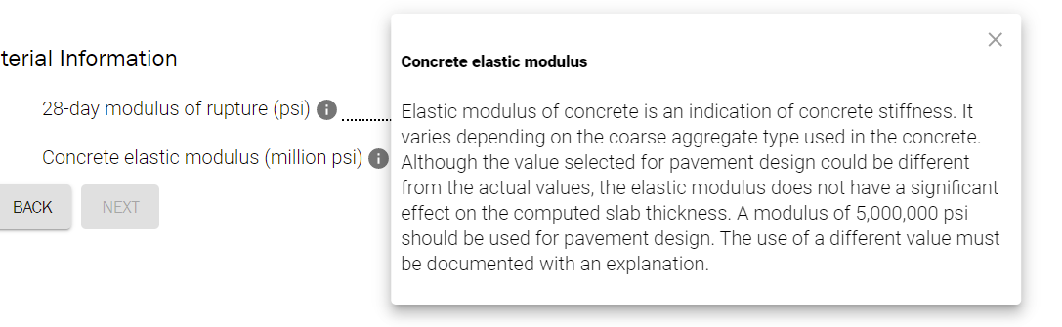

Slide 15
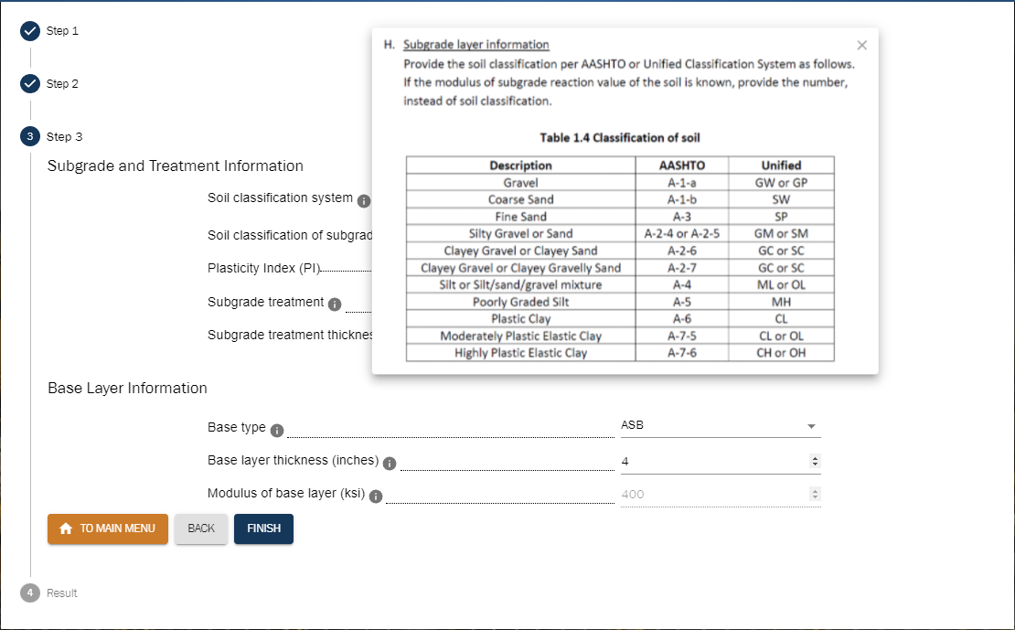
Soil Classification System – Delete/Use Higher Resolution Table

Slide 16
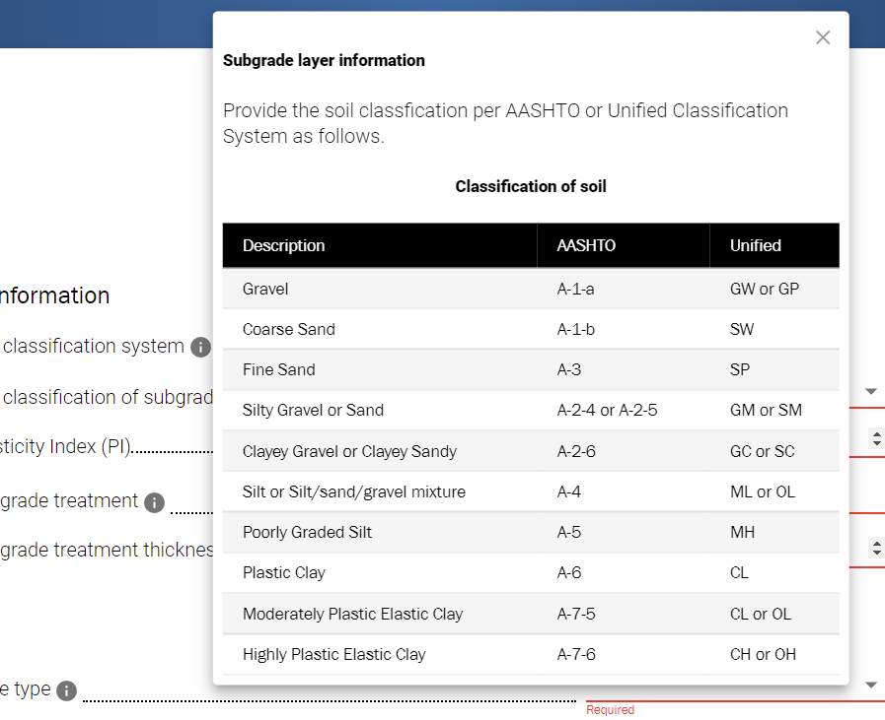

Slide 17
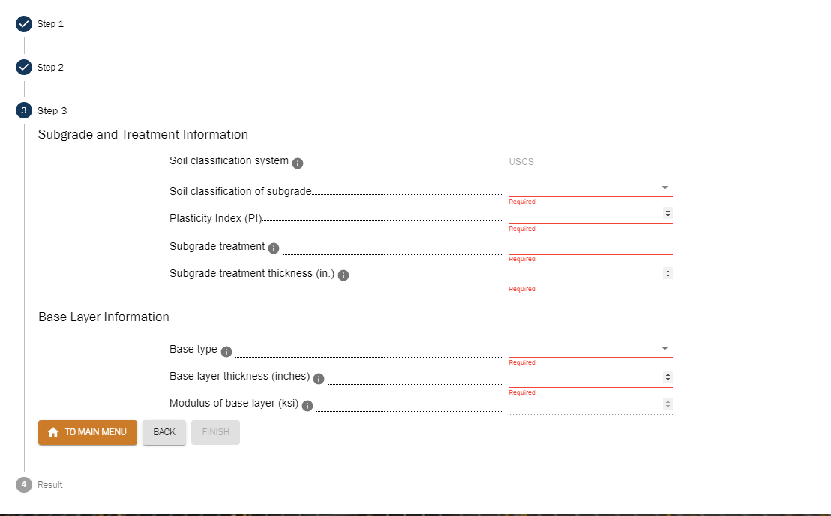
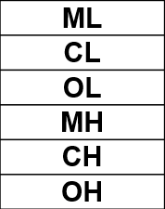
Subgrade Consideration
If a designer selects ML, CL, OL, MH, CH, or OH for soil classification of subgrade, the cement-treated base will be a recommended base type – popup window.
Popup window & Stay
“Cement Treated Base is highly recommended.”

Slide 18
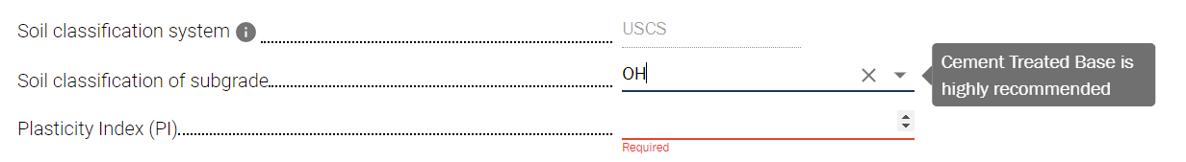

Slide 19
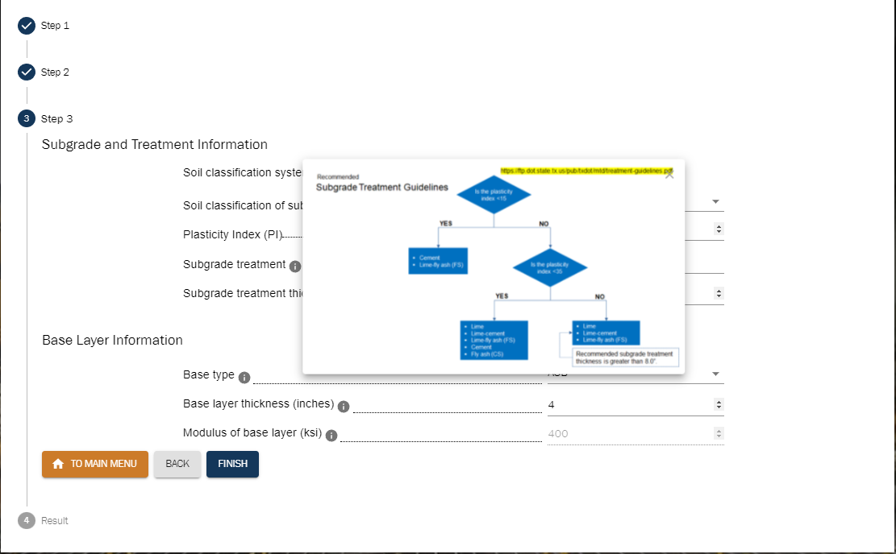
Subgrade Treatment – Use Higher Resolution Image

Slide 20
Once engineer selects subgrade type, recommended subgrade treatment guidelines should be popped up.
Recommended
Subgrade Treatment Guidelines
https://ftp.dot.state.tx.us/pub/txdot/mtd/treatment-guidelines.pdf
Is the plasticity index <15
YES
NO
Cement
Lime-fly ash (FS)
Is the plasticity index <35
YES
NO
Lime
Lime-cement
Lime-fly ash (FS)
Cement
Fly ash (CS)
Lime
Lime-cement
Lime-fly ash (FS)
Recommended subgrade treatment thickness is greater than 8.0”.

Slide 21
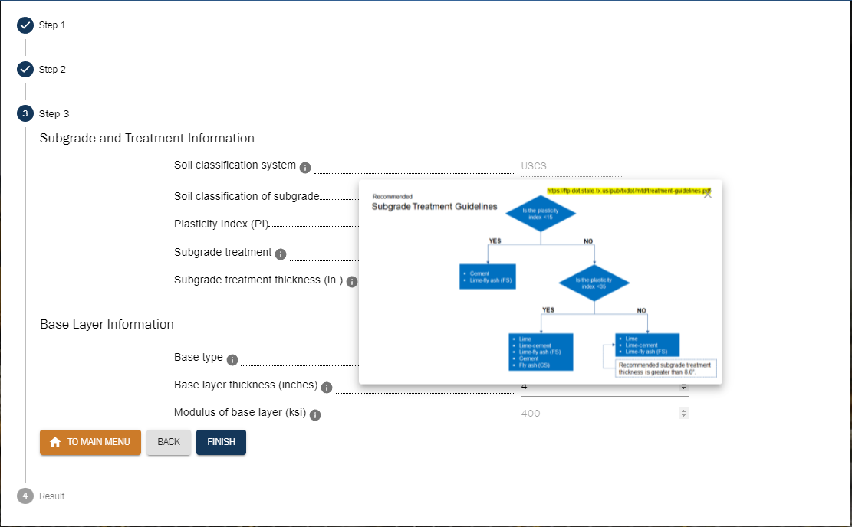
Subgrade Treatment Thickness – Use Higher Resolution Image

Slide 22
Once engineer selects subgrade type, recommended subgrade treatment guidelines should be popped up.
Recommended
Subgrade Treatment Guidelines
https://ftp.dot.state.tx.us/pub/txdot/mtd/treatment-guidelines.pdf
Is the plasticity index <15
YES
NO
Cement
Lime-fly ash (FS)
Is the plasticity index <35
YES
NO
Lime
Lime-cement
Lime-fly ash (FS)
Cement
Fly ash (CS)
Lime
Lime-cement
Lime-fly ash (FS)
Recommended subgrade treatment thickness is greater than 8.0”.

Slide 23
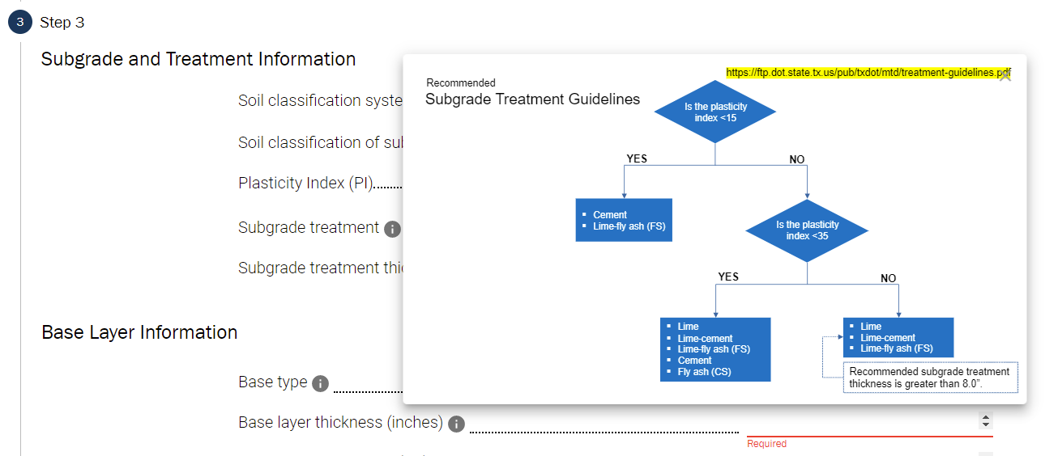

Slide 24
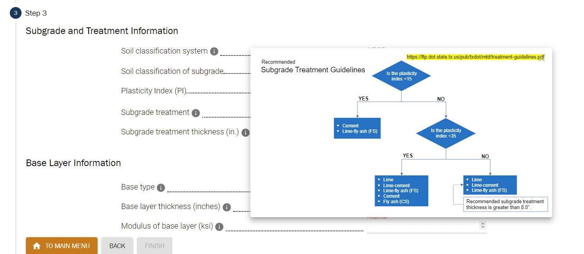

Slide 25
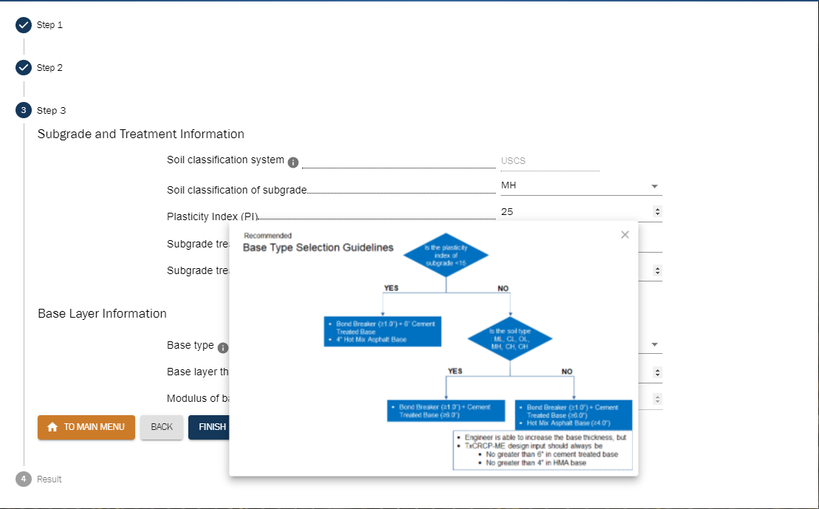
Base Type – Use Higher Resolution Image

Slide 26
If the soil types are ML, CL, OL, MH, CH, and OH, a recommended base type should be Cement Treated Base.
Recommended
Base Type Selection Guidelines
Is the plasticity index of subgrade <15
YES
NO
Bond Breaker (≥1.0”) + 6” Cement Treated Base
4” Hot Mix Asphalt Base
Is the soil type
: ML, CL, OL, MH, CH, OH
YES
NO
Bond Breaker (≥1.0”) + Cement Treated Base (≥6.0”)
Bond Breaker (≥1.0”) + Cement Treated Base (≥6.0”)
Hot Mix Asphalt Base (≥4.0”)
Engineer is able to increase the base thickness, but
TxCRCP-ME design input should always be
No greater than 6” in cement treated base
No greater than 4” in HMA base

Slide 27
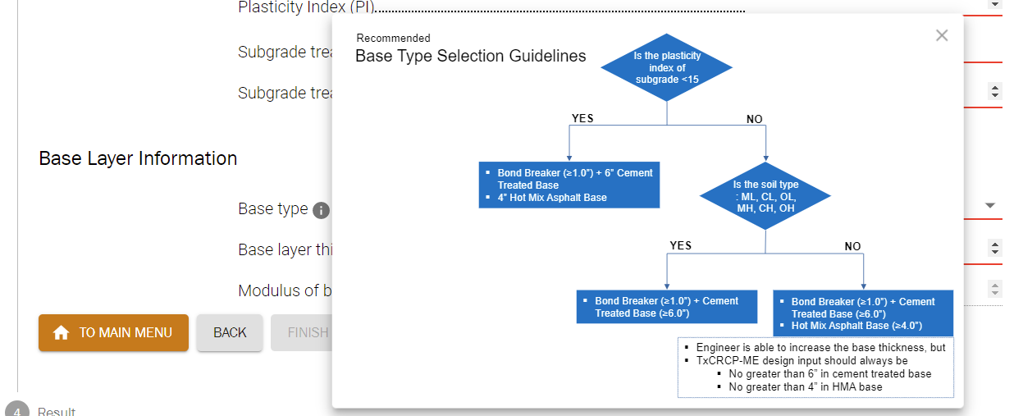

Slide 28
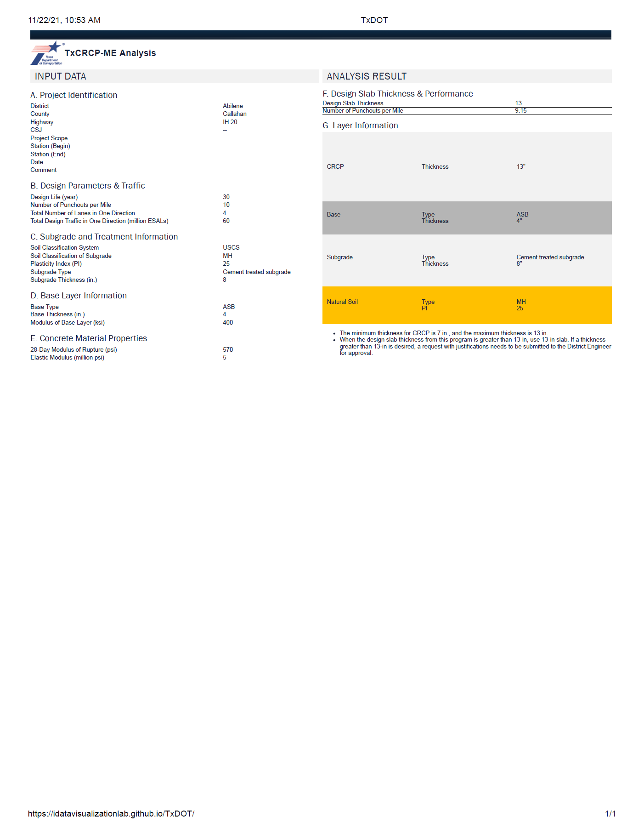
Print
Font size is too small to be included in the pavement design report.
Default Layout – Landscape with full page

Slide 30
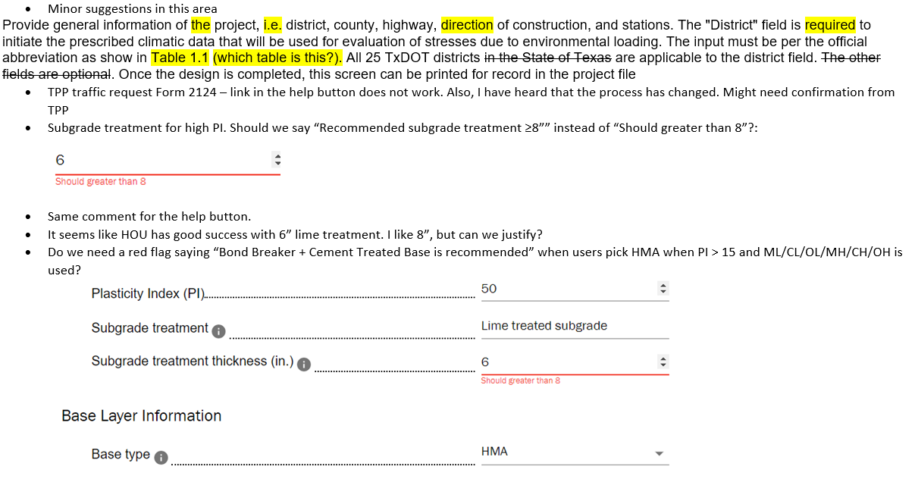
From email

